Slide 1



Application of Geoinformatics technology for Mapping Air Pollution
By
Mr. Thanayut Navachon
Mr. thawatchai kaeokhamla
Ms. Rattiya Khaehathum
IoT Data Alchemist Hackathon
In Conjunction with ASIA DATA WEEK 2017
November 16-22, 2017

Slide 2
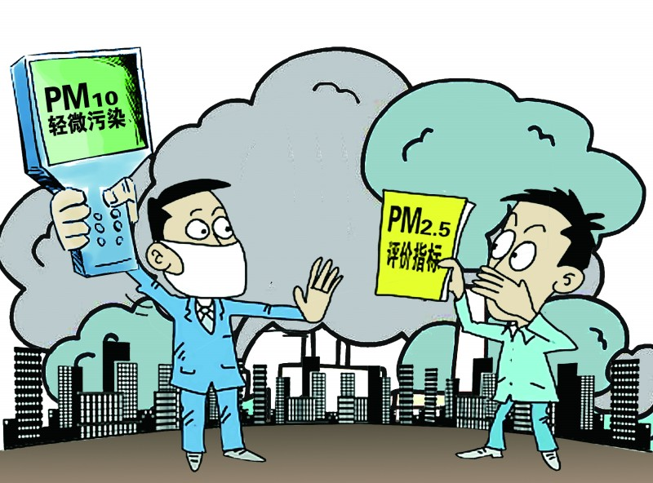
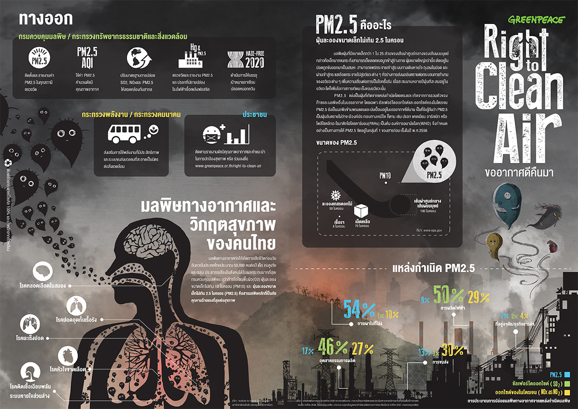
Introduction
Notes:
Now aday, there are many particles in the air and some of them are danger to human health. Air pollution occurs when harmful particles enter human body. It can cause many diseases, for examples, allergies and cancer. It also harm to other living things, like animals and crops.
So, our team wants to determine areas with high risk to air pollution, using geographic information system (GIS).

Slide 3
Objectives
To visualize air pollution level
To analyze the risk area that could affect public health

Slide 4





Tools and data
1. Software
1.1 QGIS Desktop 2.18
1.2 SQLyog Community
1.3 PostGIS, PostgREST
1.4 Google Earth Pro
2. Data
2.1 Dust particles (pm2_5value, pm10_value)
2.2 Coordinates (latitude and longitude)
2.3 Houses/parcel map (Google Earth Pro)

Slide 5
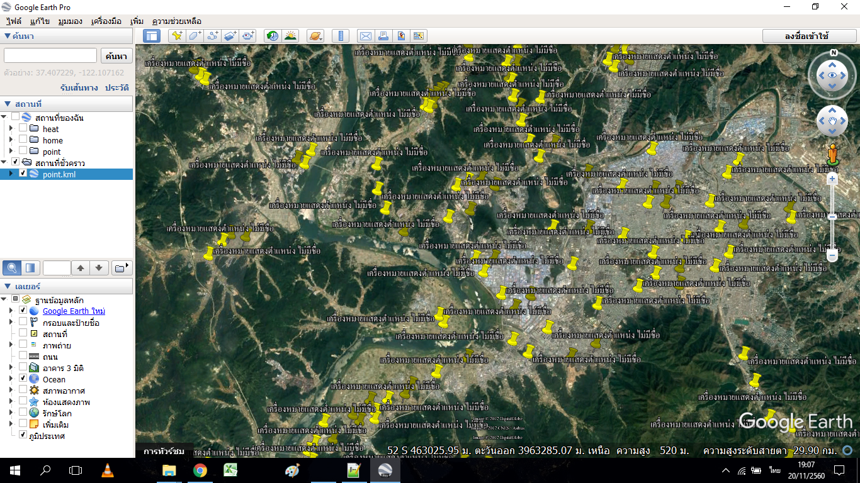
Methodology
Mark point
Notes:
- Because we didn’t have parcel map, we then created building points in Google Earth manually. We used these building points to demonstrate the GIS application on finding houses that affected by air pollution. We created around 1000 dummy building points.

Slide 6


Methodology (cont’d)
Point = 4,253,003
Notes:
We started by collecting 40 days from KISTI server and saved them as CSV files. There were 34 cars, and each car had around 6000 data. Therefore, we got more than 4 million data points.
After that, we imported CSV files into QGIS, and converted them to ESRI shapefile.

Slide 7
Methodology (cont’d)
< 60 ppm
60 – 120 ppm
> 120 ppm
Notes:
Next, we classified the data-points into 3 classes as shown in the figure. Here, we set the threshold to 120 microgram/m3
Any data-point that had more than 120 microgram/m3 were classified as risk points.

Slide 8
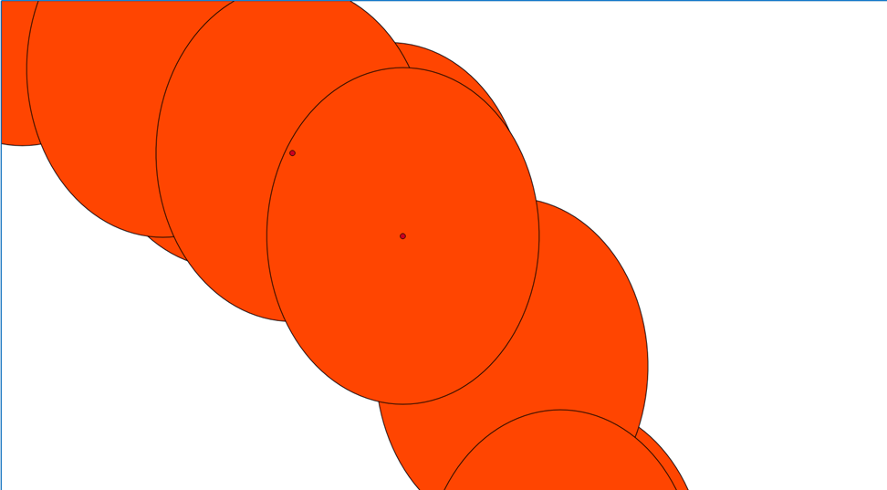
Methodology (cont’d)
Risk point
25 m.
House
Notes:
- Given the risk points, we generated risk areas by computing buffer around the risk points. This was done in QGIS using fixed distance buffer function. In this workshop, we set the radius of the buffer to 25m.

Slide 9
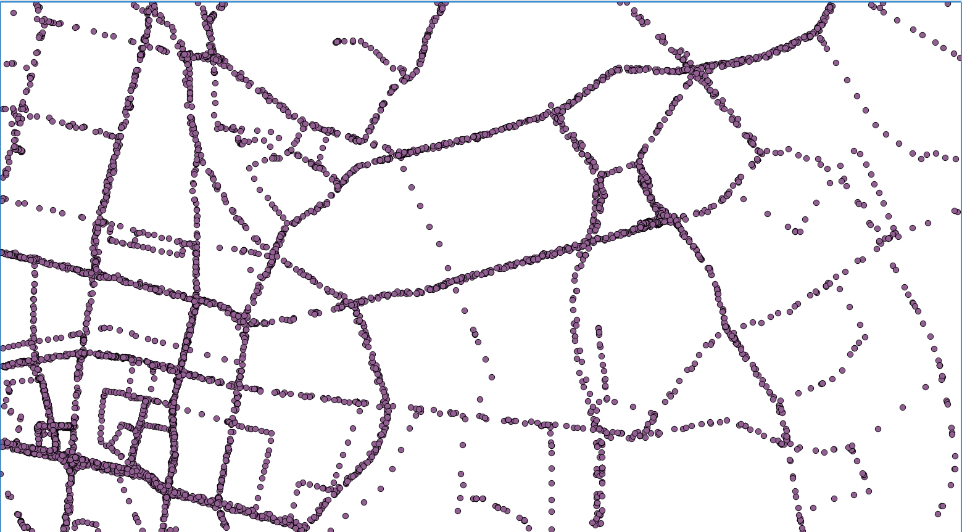
Result
Raw data
Notes:
This figure showed the raw data, after importing into QGIS.

Slide 10
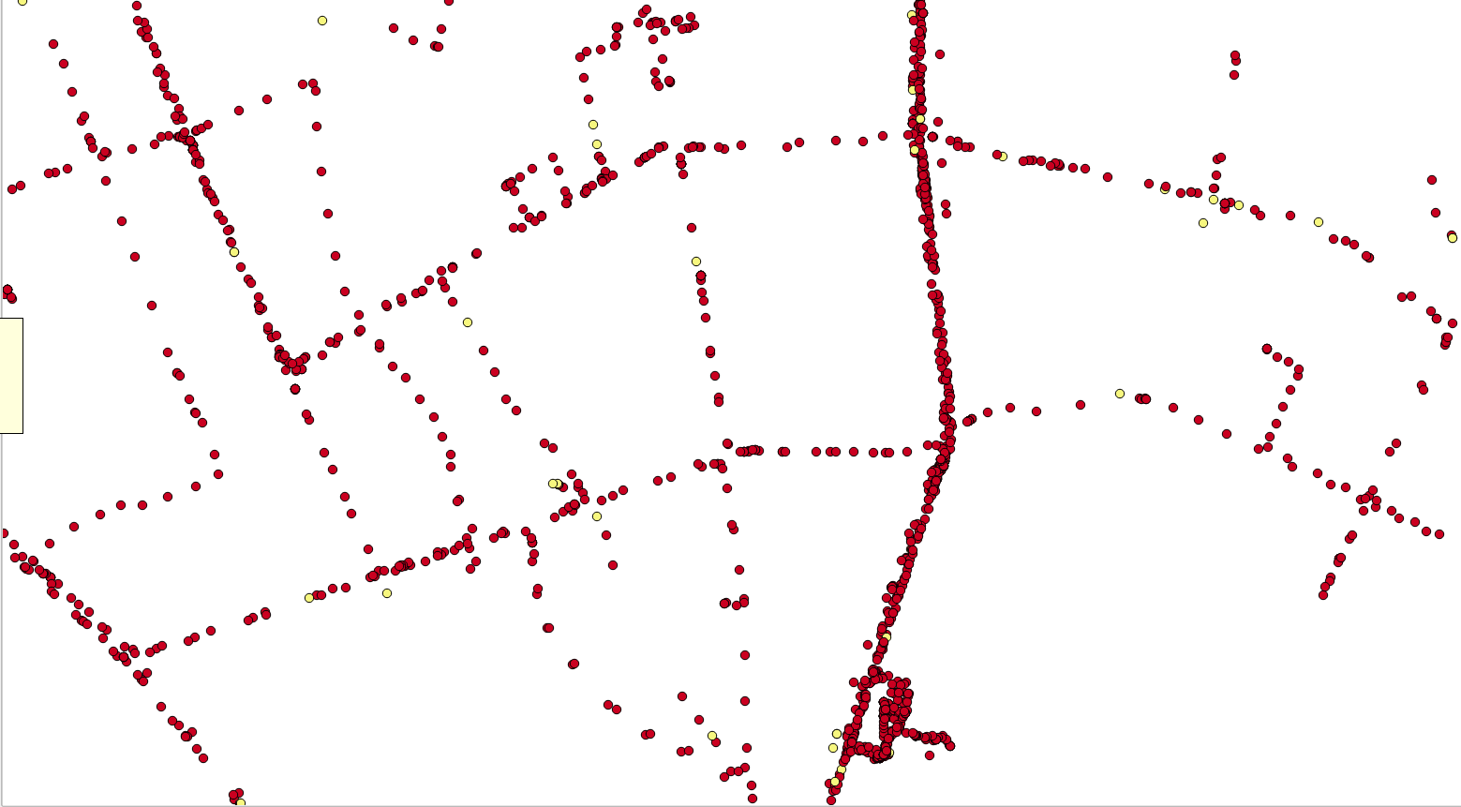
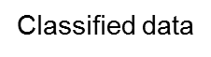
R
High risk point
Low risk point
Classified data
Notes:
This figure showed the data-points after classifying using our criteria.
Here, the big red dots were the high-risk datapoints. The low-risk points were shown as yellow dots.

Slide 11
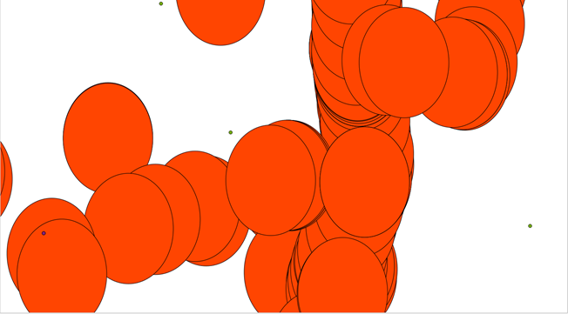

Result
Notes:
2. In this figure, each circle was the buffer generated from each high-risk point

Slide 12
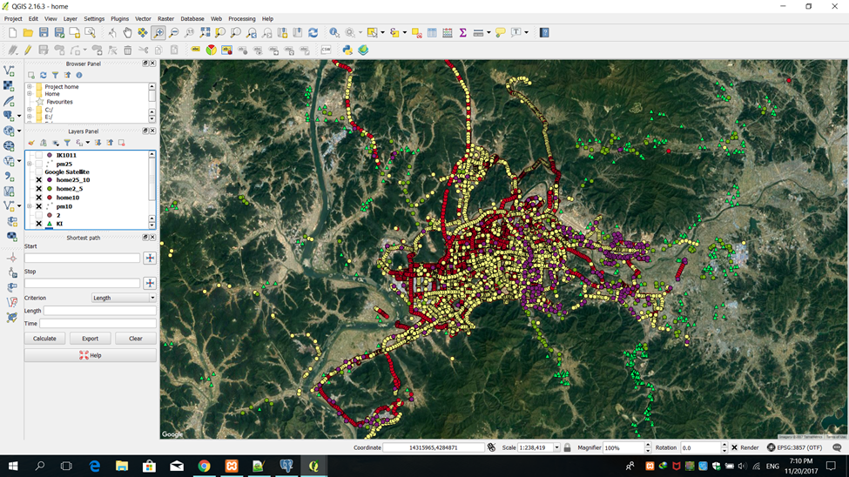

Notes:
- These were an overview of the results. There were more than 4 millions data-points in this figure.

Slide 13
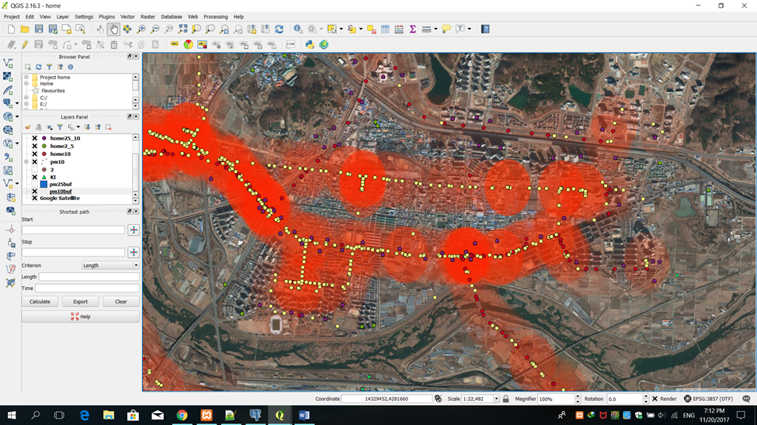
Buffer
Houses
Risk point
Notes:
Here, the risk points were shown as red dots and the red circles were their associated buffers. Please note that we showed buffers before dissolving into a single polygon.
In this figure, the dummy houses were shown as the green triangles.

Slide 14
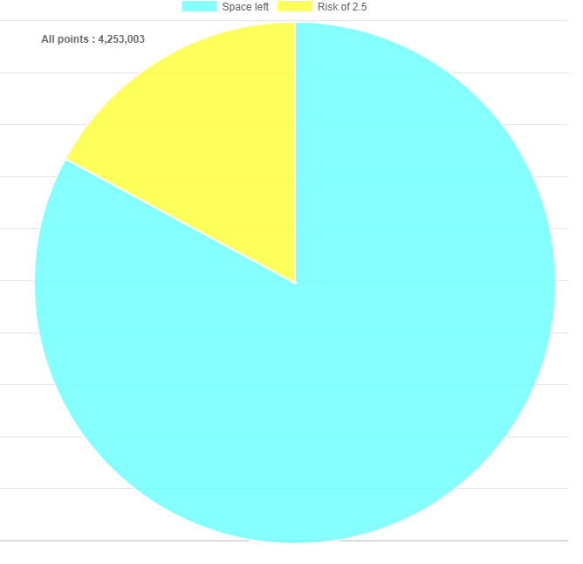
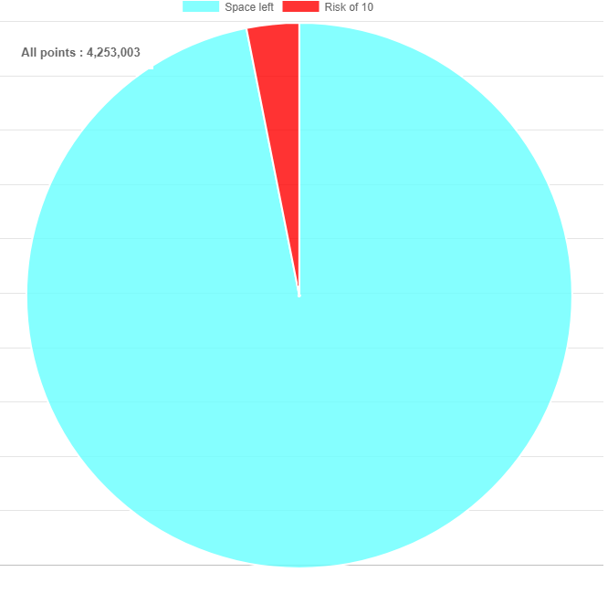
Graph
PM 2.5 = 727,823 (16%)
PM 10 = 132,187 (3%)
Notes:
We compared the number of high-risk data-points using pm2.5 data and found that there were around 700,000 data-points, or around 16 %.
In the case of PM 10, there were around 100,000 data-points or around 3%.

Slide 15
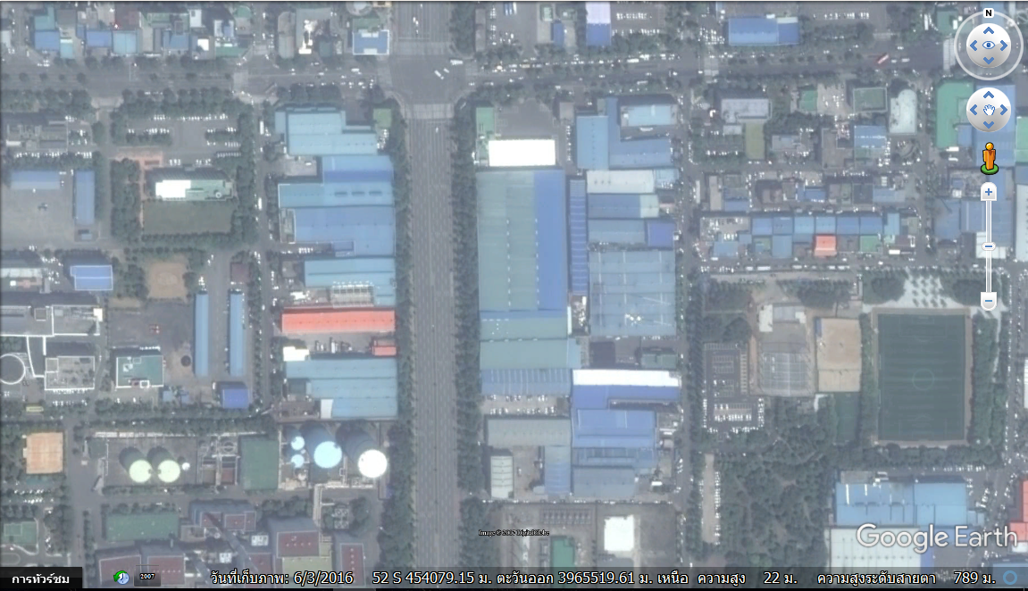
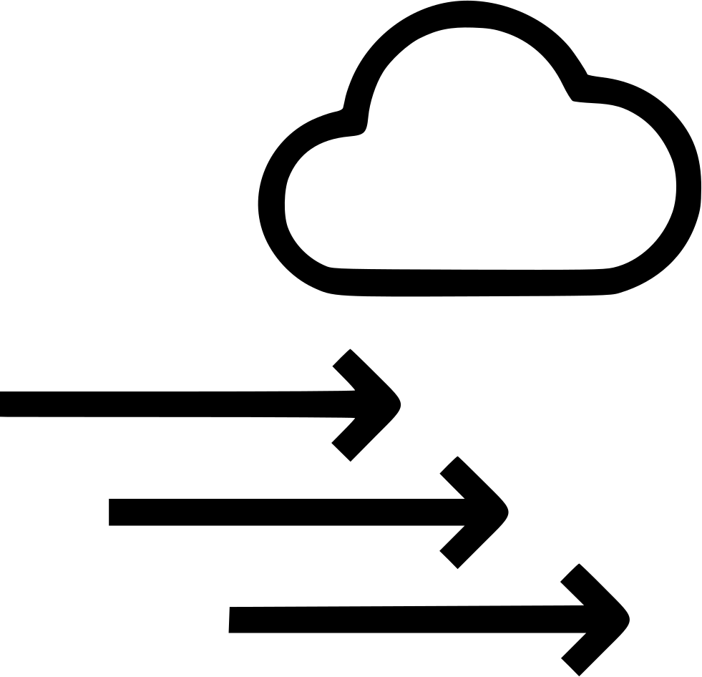
Discussions
Notes:
We used only pm values. It could be better to add another factors to the calculation, such as time, wind speed and wind directions.
Also, if we have the real parcel map, we can obtain more accurate results.

Slide 16
Thanks!

